Slide 1
Introduction
Feb 2018

Slide 2



Introduction
Founded in Early 2016
For B2B Marketing/Sales Teams
For Tech Companies
SaaS Product deployed on AWS
Easy to Maintain
Automated
Measured ROI
Integrated

Slide 3
Sales Enablement Challenges
Marketing Efficiency
Sales Content Success
Data Driven Enablement
Content difficult to organize
Tagging does not scale
Lack of quality control
Content in multiple sources
Manual content distribution
Sales can’t find content
Content search fails
Sales reps don’t pull content
Sales reps don’t need new apps
Low content ROI
Marketing cannot track coverage
No insight in to sales needs
Lack of best practices

Slide 4
Marketing & Sales Content Management
Organize access and distribution across multiple content sources.
Content Sources
Content Sources
Centralized & Organized Content
Sales Engagement
Content Sources

Slide 5
Enablix Sales Enablement Platform
Marketing Efficiency
Sales Content Success
Data Driven Enablement
Automate
Content Organization
Targeted
Recommendations
Measure Content
ROI
Leverage
Multiple Sources
Enhanced
Search
Track Content
Gaps
Ensure Quality
Control & Privacy
Browse &
Filter
Sales Engagement

Slide 6














Integrates with your application ecosystem
Sales Apps (CRM & Others)
Content Management Systems
Communication Tools

Slide 7
Roadmap
New UI (Mar 2018)
Enhanced Content Workflows (Mar 2018)
Text mining for automating content capture (Jun 2018)
Enablement Campaigns (Sales On-Boarding, etc.)
New Integrations (Egnyte, Salesloft, etc.)

Slide 8
Appendix

Slide 9
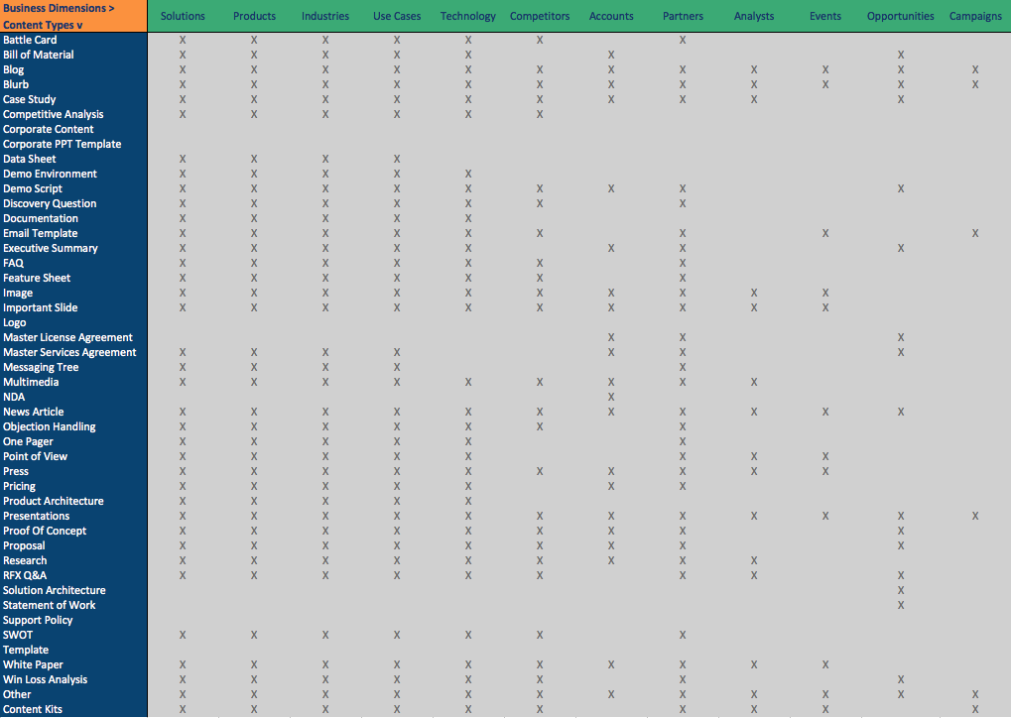
Content Catalog for Technology Companies
Content is applicable across several key business dimensions of your organization
A comprehensive content catalog is required to enable sales

Slide 10
Relevance and context is critical
Factors that make content relevant (or irrelevant)
Geography
Product
Competitor
Market Segment/Tier
Deal Stage
Sales Rep Tenure
Sales Rep Wins/Losses
Sales Rep Pipeline
Time of the Fiscal Year
Content Type
Distribution Channel
Content Popularity
Etc…
What
you want
to say.
What
They’re
Interested
in.
RELEVANCE

Slide 11
AI using Bayesian Networks
Content Updated
New Responsibilities
Peer Users Accessed Content
Peer Users Accessed Type
New Employee
Content Added
Content Updated after Recent Access
Hungry For Content
Popular Among Peers
Recent Content
Popular Content
Mapped Content Type
Relevant Content
Content Shared Recently
Irrelevant Content
Repetitive Content
Accessed Same Content Recently
Matching Dimensions
Relevant to Active Opportunity
Accessed Similar Content Recently
Accessed As Part of an Opportunity
Shared as part of an Opportunity

